Slide 1
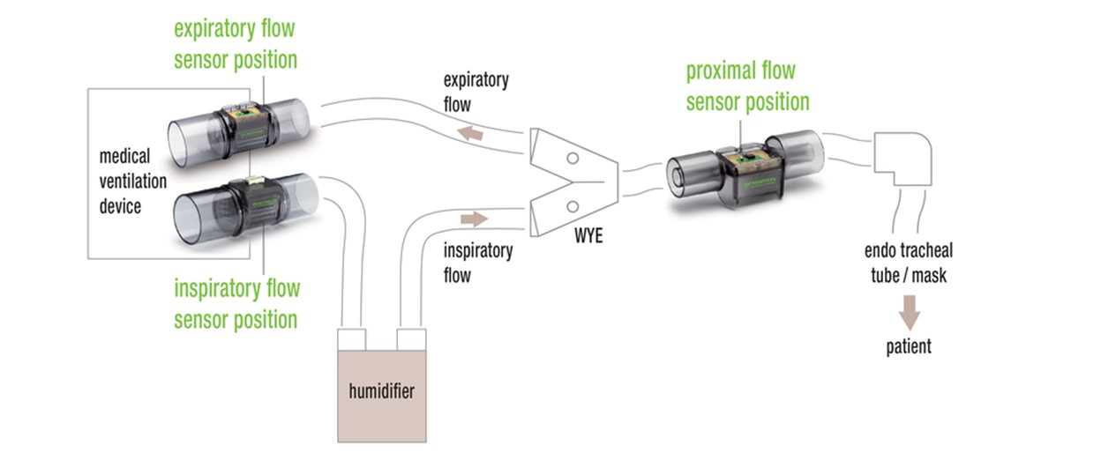
Flow sensor placement options
Diagram from Sensirion demonstrates 2 conventional methods:
Proximal flow sensing, uses a single bi-directional sensor placed at the patient interface.
Machine flow sensing, uses 2 directional sensors located at the machine. Expiratory flow sensor required decontamination of replacement between patients.
In machine flow sensing the first measures inspiration tidal volume (Vti), representing what the machine put into the circuit. The second sensor measures expiration tidal volume (Vte). The difference between the two represents a leak in the system. Vte is usually taken to represent the patient volume (Vt).

Slide 2
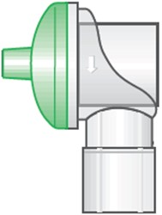
Revised schematic
Pressure
monitor
Safety shutdown
PIP control
Flow (Vti)
monitor
Pressure
control
PEEP control
SV1
SV2
PR
Ptr3
Ptr1
Gas Output
Flow rate 60 L/min
4mbar to 35mbar (in breathing circuit)
22mm conical connector, Male
2.5bar to 5bar
2 metres, 8mm PU
NC
NC
Receives pre-blended gas between 21% and 50% oxygen concentration
Ptr2
NR1 22mm
SV3
Pressure monitor
All internal tubes are 6mm PU
FR1
NC
Gas Return
FR2
NR2 22mm
Exhaust
Exhaust
Implementation of inspiration tidal volume (Vti) measurement, representing what the machine put into the circuit.
Endotracheal tubes feature a sealing cuff and Vti can reliably indicate what the patient receives. In mask ventilation, some of the delivered volume is lost due to mask leaks.

Slide 3
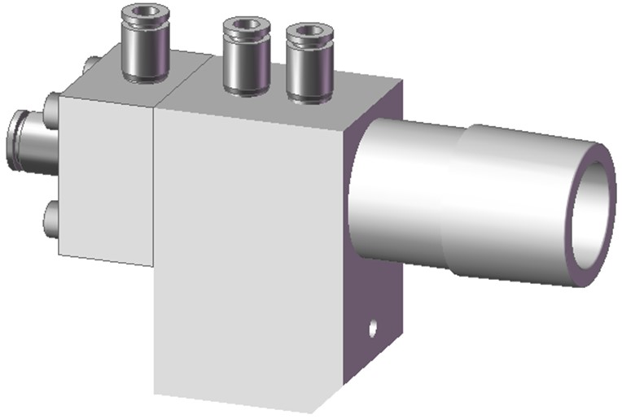
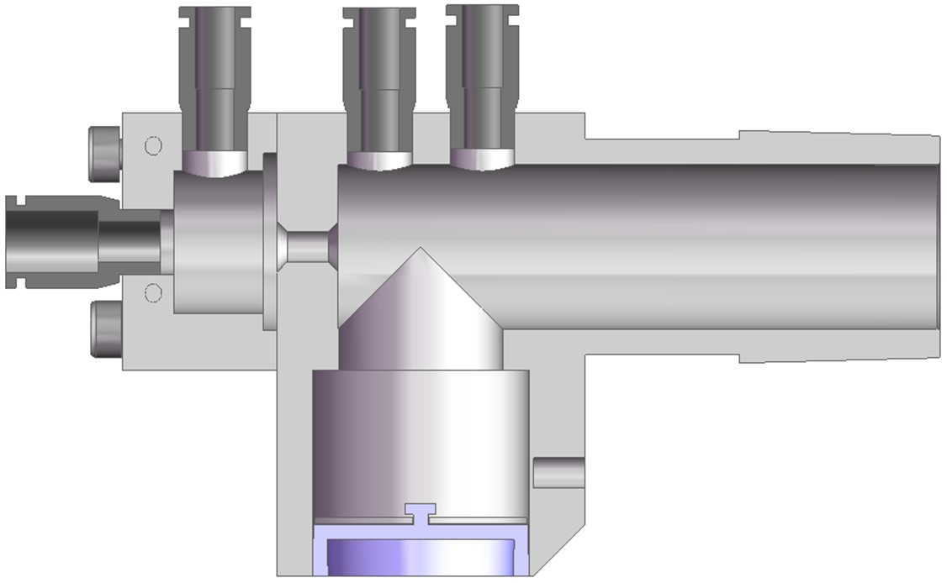
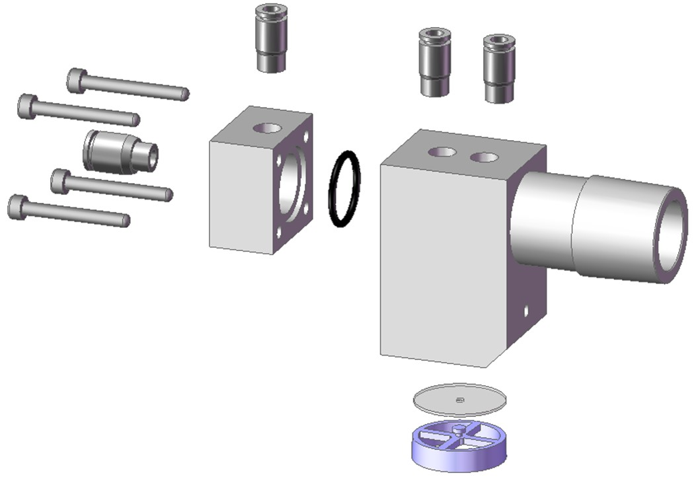
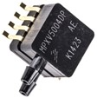
Flow sensor
¼” to 4mm tube connector (to PTR3+)
¼” to 4mm tube connector (to PTR3+)
¼” to 6mm tube connector (from SV2)
¼” to 4mm tube connector (to PTR1)
Pressure differential across the orifice is proportional to the flow rate
2.5mm orifice With chamfered edges to reduce turbulence noise
P+
P-
22mm Male conical connector
Diff.P
20mbar
Directional valve
Same pressure sensor as PTR1 and PTR2
Mass flow rate
0mbar
0L/min
80L/min

Slide 4
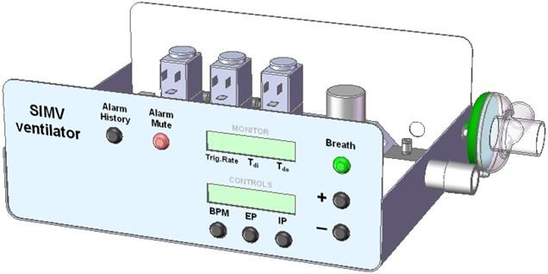
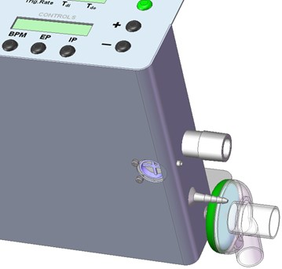
Layout
Ambient breath intake on ventilator failure
3 x M3 fixing screws
LCD display requires extending to 20 characters, to display the Vti value in ml.
Vti measurement starts immediately SV2 and SV3 opens and ends when the Ti ends. Flow measurements taken every 2mS are added up to calculate the delivered volume.
Vti is a monitoring tool, used by clinicians to observe changes in lung compliance and estimating the patint Vt.
It is not safe to use Vti only for Volume Control ventilation, because it does not register any leak.

